Slide 1
Azure IoT Services
Sabyasachi Pathak
IoT Digital
29-Nov-2020

Slide 2
Agenda
Introduction – IoT Data flow and Lambda Architecture and Subsystems
Introduction – Azure IoT Reference Framework
Introduction – Sensors Devices Gateways
Introduction – Cloud Gateway and IoT Hub
Lab – Things | Insights |Actions
Device Communications – Azure IoT Hub Tiers
Device Communications – Endpoints
Device Communications – IoT Hub Security
Device Communications – Device Life Cycle
Device Communications – IoT Devices | Device Identity | Device Twin
IoT Developer Tool – IoT Hub Device SDK
IoT Developer Tool – IoT Hub Service SDK
IoT Developer Tool – VS , VS Code , CLI , Cloud Shell , Power Shell

Slide 3
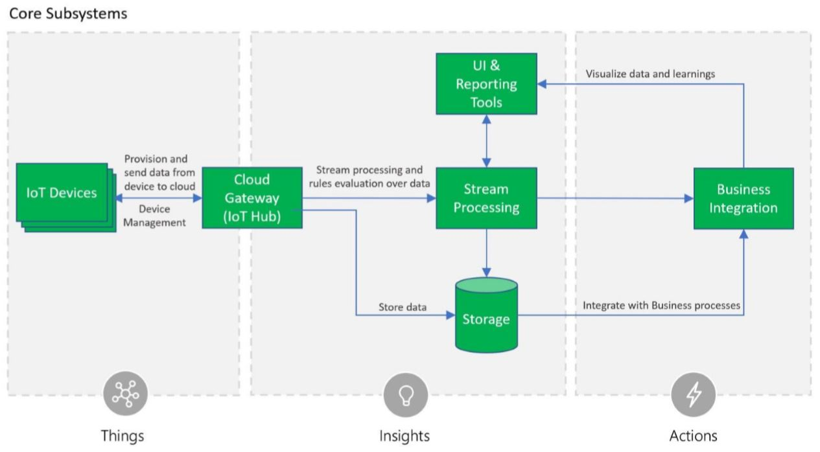
Introduction – IoT Data flow and Lambda Architecture
IoT Data Flow-Core Sub System

Slide 4
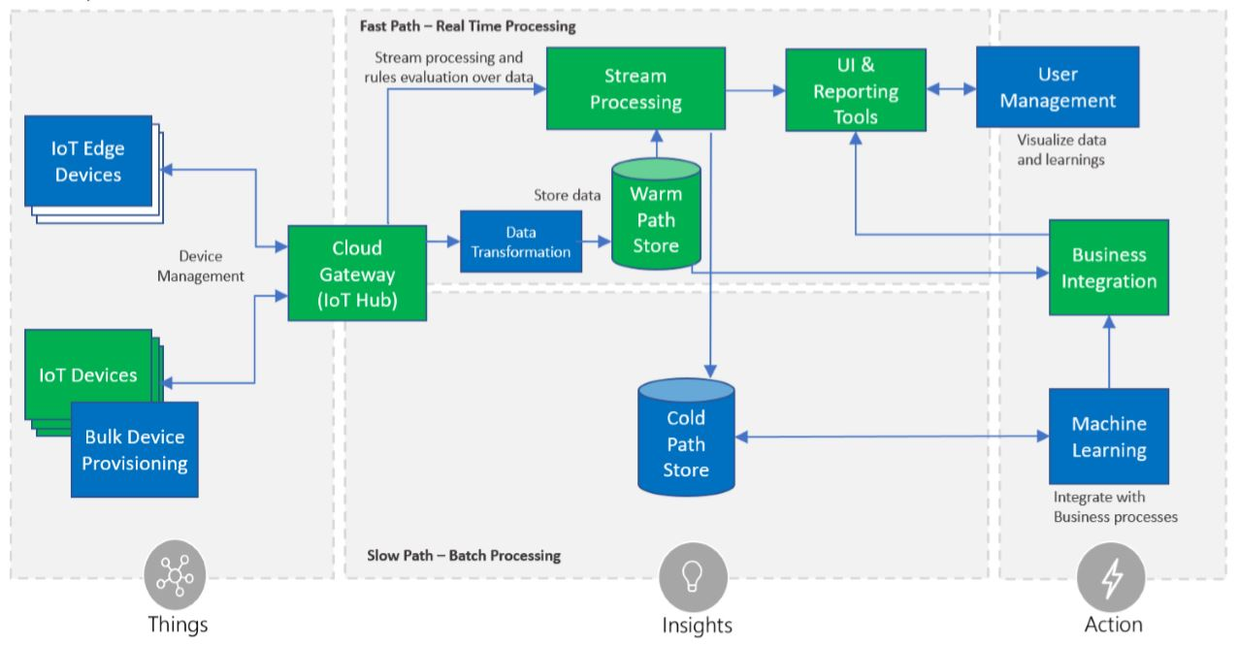
Introduction – IoT Data flow and Lambda Architecture
IoT Data Flow- Optional Sub Systems

Slide 5
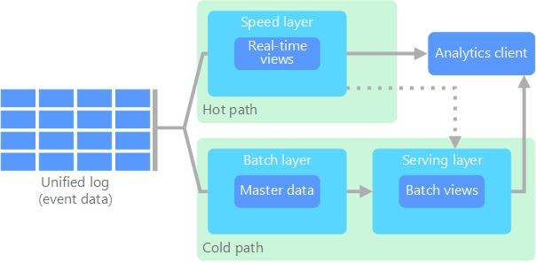
Introduction – IoT Data flow and Lambda Architecture
IoT Data Flow- Lambda Architecture
https://docs.microsoft.com/en-us/azure/architecture/data-guide/big-data/

Slide 6
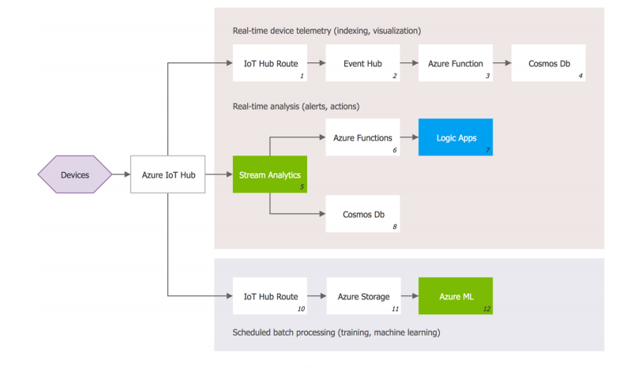
MS IoT –Data Flow

Slide 7
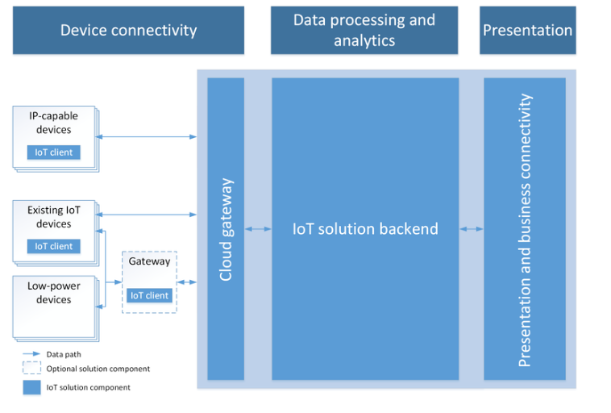
MS IoT – Reference Architecture

Slide 8
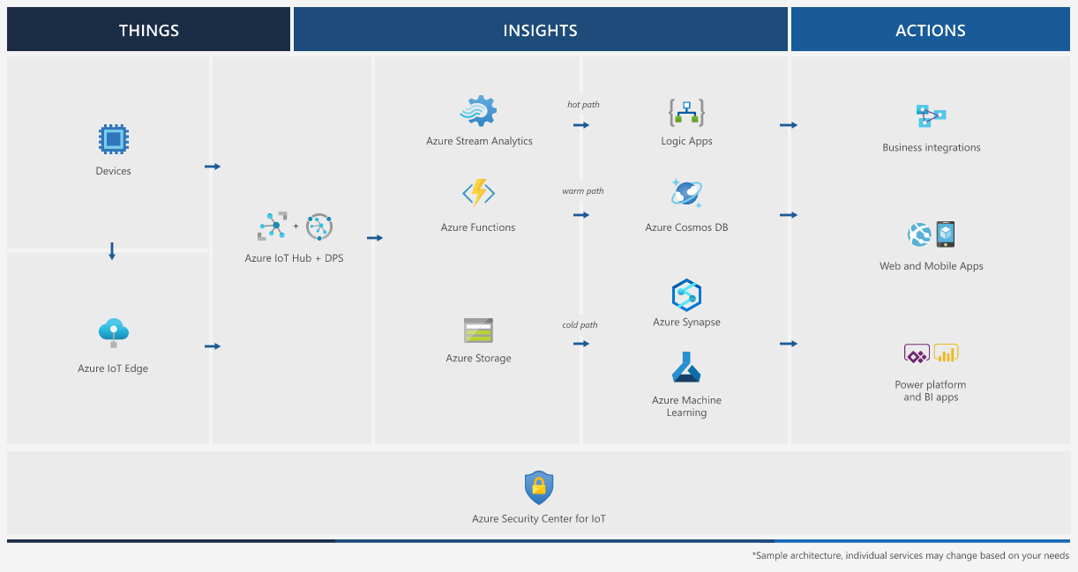
Introduction – Azure IoT Reference Framework
Azure IoT Reference Architecture
https://docs.microsoft.com/en-us/azure/architecture/reference-architectures/iot

Slide 9
Introduction – Devices and Device Operating System
OS | Type | Description
Windows IoT Core | Managed | Windows IoT Core is a version of Windows 10 that is optimized for smaller devices with or without a display that run on both ARM and x86/x64 devices.
Ubuntu Core | Open Source | "Ubuntu Core uses the same kernel, libraries and system software as classic Ubuntu. You can develop snaps on your Ubuntu PC just like any other application. The difference is that it’s been built for the Internet of Things."
Riot | Open Source | "RIOT supports most low-power IoT devices and microcontroller architectures (32-bit, 16-bit, 8-bit). RIOT aims to implement all relevant open standards supporting an Internet of Things that is connected, secure, durable & privacy-friendly."
QNX | Managed | "Through sophisticated software solutions BlackBerry® QNX helps ensure the proper operation of embedded systems that require mission-critical and life-critical operations. Since 1980, BlackBerry QNX has established itself as a trusted partner for companies building vehicles, medical devices, heavy machinery, power and energy, robotics, and industrial automation systems that are required to be safety-certified, extremely reliable, and highly secure."
Android Automotive | Managed | "Android Automotive is a variation of Google's Android operating system, tailored for its use in vehicle dashboards."

Slide 10
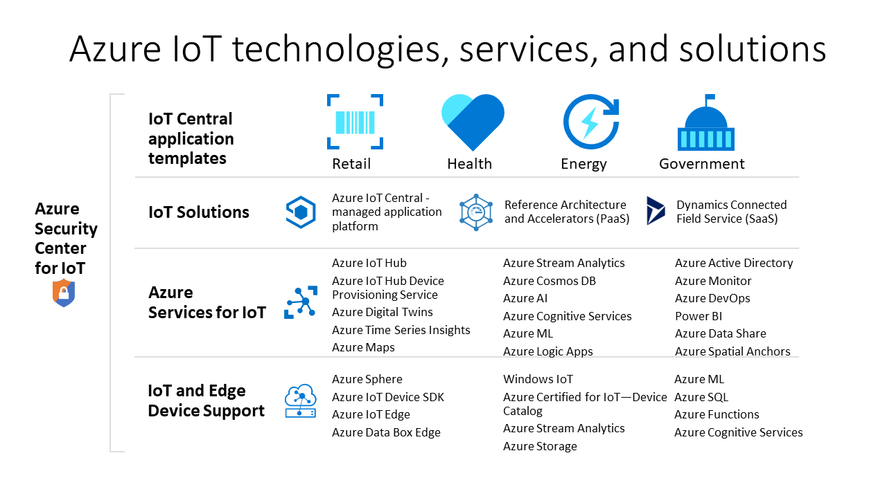
Introduction – IoT Services

Slide 11
MS IoT –Azure IoT Hub
Definition:
Connect, monitor and manage billions of IoT assets—Use Azure IoT Hub to securely connect, monitor and manage billions of devices to develop Internet of Things (IoT) applications. IoT Hub is an open and flexible cloud platform as a service that supports open-source SDKs and multiple protocols.
Usage :
Establish bidirectional communication with billions of IoT devices
Authenticate per device for security-enhanced IoT solutions
Automate IoT device provisioning and registration to accelerate your IoT deployment
Extend the power of the cloud to your edge device
Extend the power of the cloud to your edge device

Slide 12
MS IoT –Features
Connection
bidirectional comunication
reliable & secure channel
per-device authentication
multiplexing
Features
device to cloud telemetry
cloud to device commands and notifications (with TTL & feedback)
bulk uploads/downloads
monitoring devices (connection, activity, ...)
multi protocols (AMQP, HTTP) → IoT Protocol Gateway (MQTT)

Slide 13
Thank you
Nikunj Thakkar, Sabyasachi Pathak
IoT Digital
30-May-2018

